Slide 1
Data Polish

Slide 2
Agenda
Work Done
Work Planned
Updated Technical Flow
Demo

Slide 3

Work Completed!
Data Profiling dashboard
All charts created.
Data Cleaning
Functionality finished
UI created
Login System
Backend API created for registration, login, logout
User authentication added to all pages
Architecture update
Updated complexity in the technical flows

Slide 4
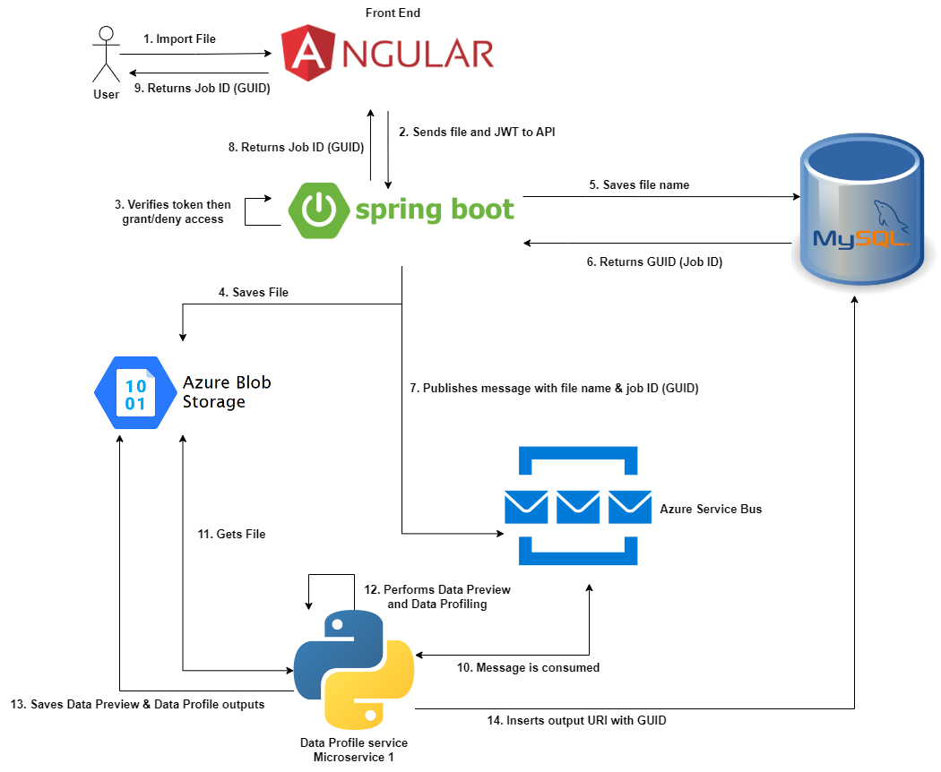
Technical Flow - File Upload

Slide 5
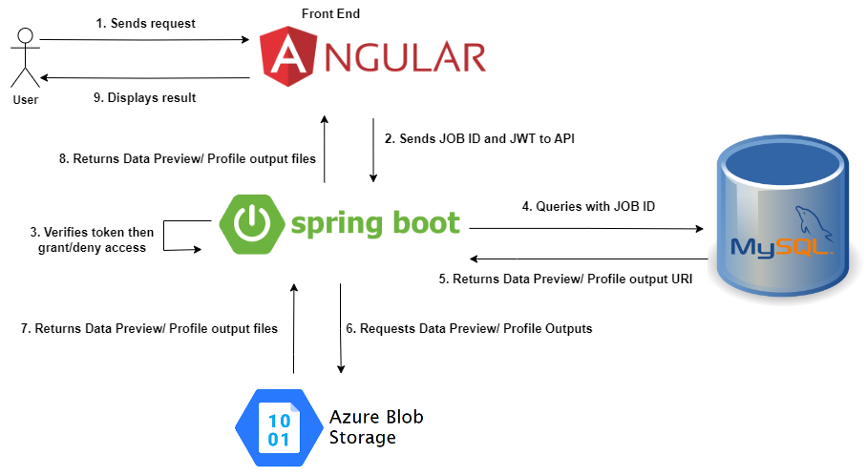
Technical Flow – Data Preview & Profile

Slide 6
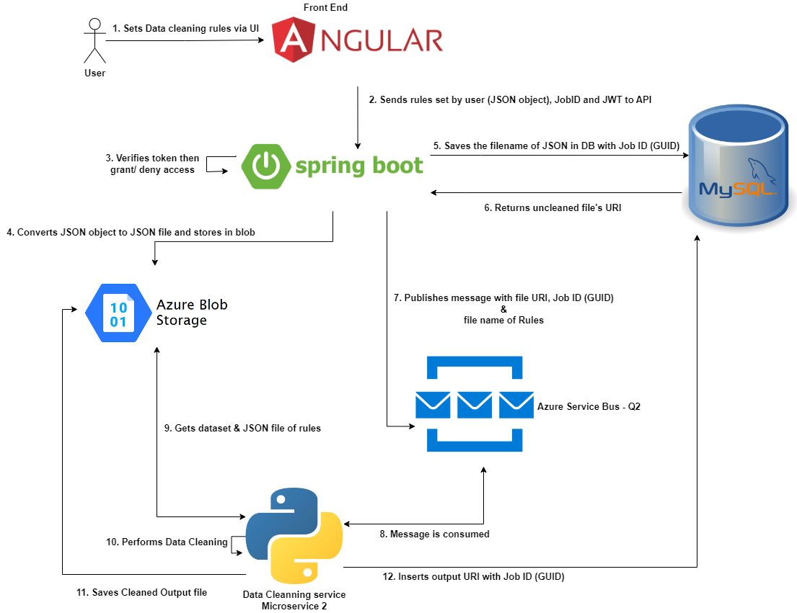
Technical Flow – Data Cleaning

Slide 7
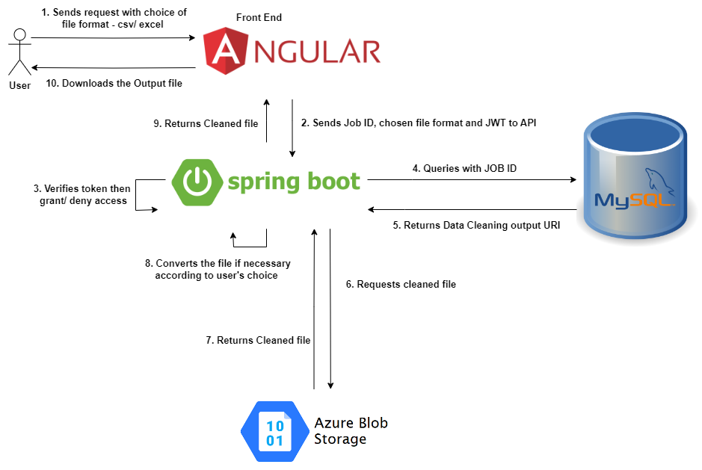
Technical Flow – File Download

Slide 8
Coming next Friday!
Full integration of dashboard and UI update.
Full integration of column cleaning and UI update.
Evaluation phase 3
Software and integration testing.

